Slide 1
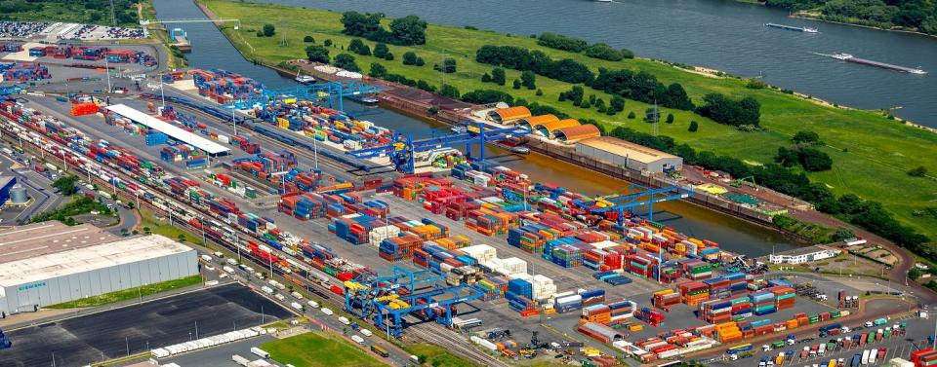
“Smart Investment”
Ports and Intermodal Terminals

Slide 2
Port and Intermodal Transport
Challenges and risks
SAFETY
DAILY PERFORMANCE
OPERATIONAL COMPLEXITY
COMPETITION
PROFITABILITY
TROUGHPUT
YARD PRODUCTIVITY
SATISFYING YOUR CLIENTS

Slide 3
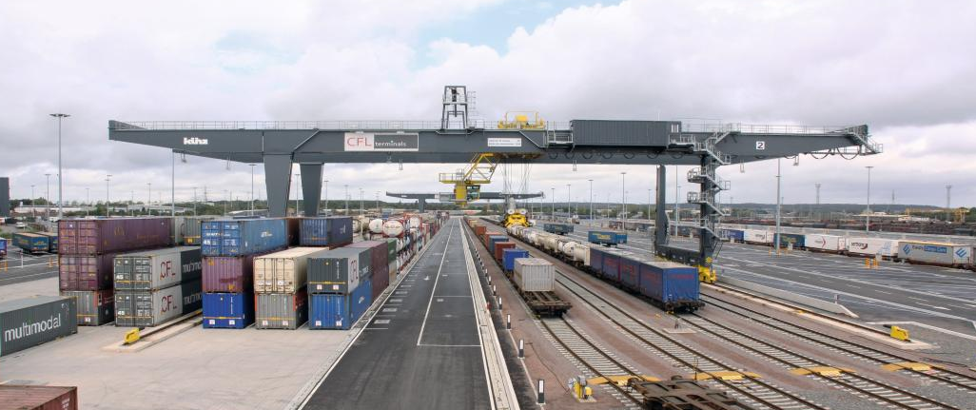
TERMINAL CHALLENGES
movie

Slide 4
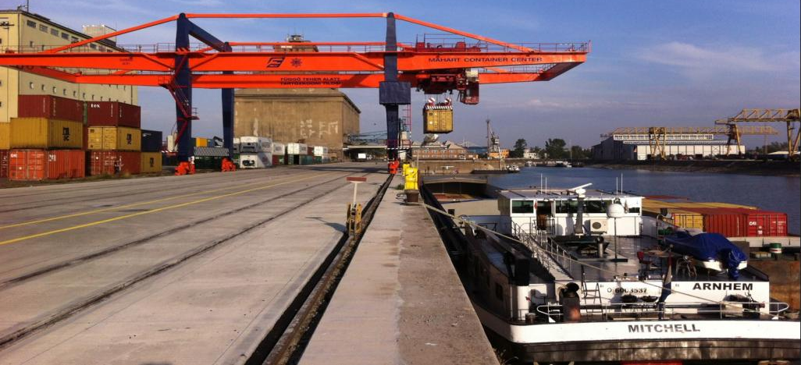
Port and Intermodal Transport
Maximizing efficiency
IMPROVING SAFETY
MORE EFFICIENT FREIGHT HANDLING
MORE PROFITABLE WHEN MARGINS ARE SHRINKING
A STEP AHEAD TOWARDS COMPETITION
DOING MORE WITH LESS SPACE
ACCURATE DATA
INVENTORY AND DAMAGE CLAIMS
YOU CAN SET NEW GOALS
BETTER SERVICE TOWARDS YOUR CLIENTS

Slide 5
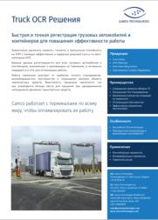
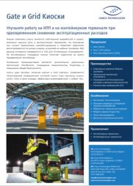
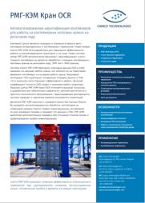
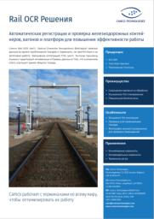
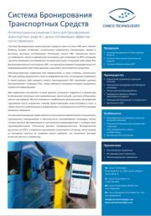
“Smart Investment”
Ports and Intermodal Terminals

Slide 6
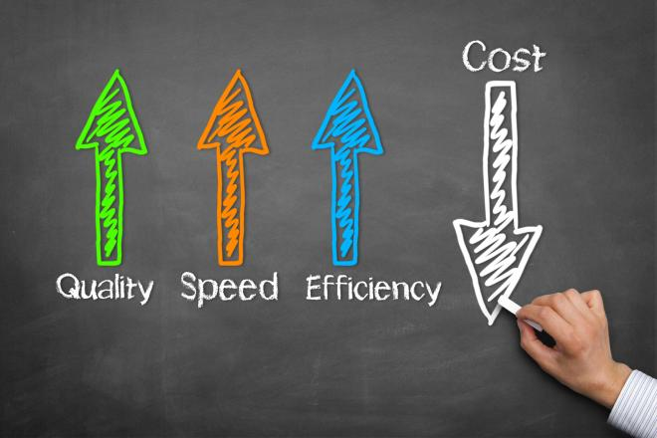
Investing in automation

